Slide 1

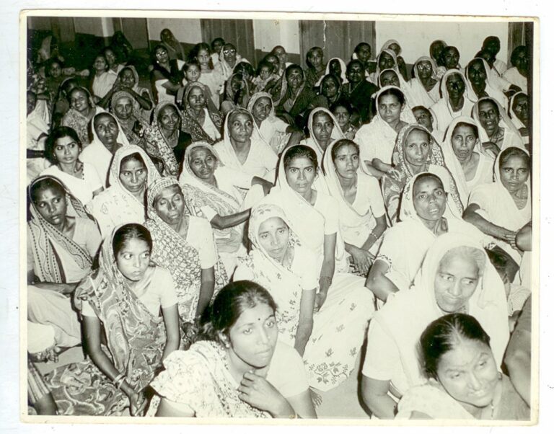

SELF-EMPLOYED WOMEN’S ASSOCIATION
SINCE 12TH APRIL, 1972

Slide 2




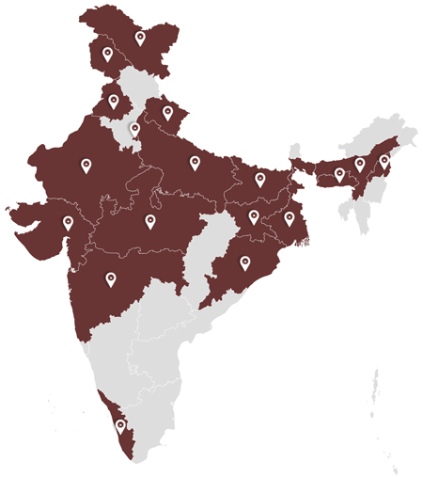
SDG goals for case study:
Stakeholders:
SEWA MEMBERS
SEWA LEADERSHIP
NGO’S
GOVERNMENT AGENCIES
LOCAL COMMUNITIES
SELF-EMPLOYED WOMEN
18 STATES IN INDIA
2.9 MILLION WORKERS

Slide 3
CHALLANGES
External Circumstances
Internal Constraints
Political- Economic factors
Resource Allocation Dilemmas
Limitations imposed by society
Long working hours with low returns

Slide 4
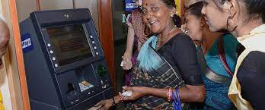

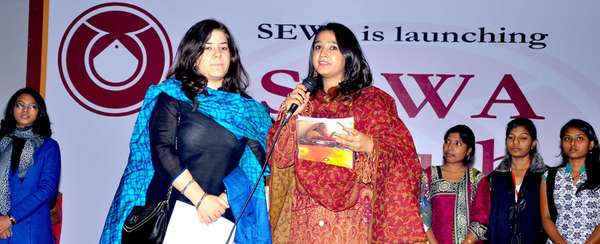
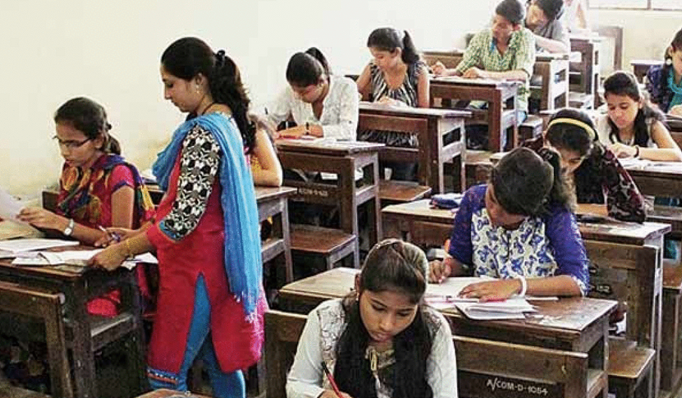
SOLUTIONS
Access to Finance
Strategic Partnerships
Strategic Planning
Skill Enhancement Programs

Slide 5
INCREASED RECOGNITION AND INCLUSION
OUTCOMES
ENHANCED ECONOMIC EMPOWERMENT
EMPOWERMENT AND LEADERSHIP
REDUCED GENDER DISPARITIES

Slide 6


Q&A SESSION
1. How has SEWA directly impacted the lives of self-employed women in the communities it serves?
2. What skill development has led to notable economic empowerment for self-employed women?
3. How has the organization adapted its strategies to overcome challenges faced in addressing gender inequality?
4. How do you think, did the SEWA's policy advocacy efforts contribute to sensible improvements in the legal and policy frameworks supporting self-employed women?

Slide 7
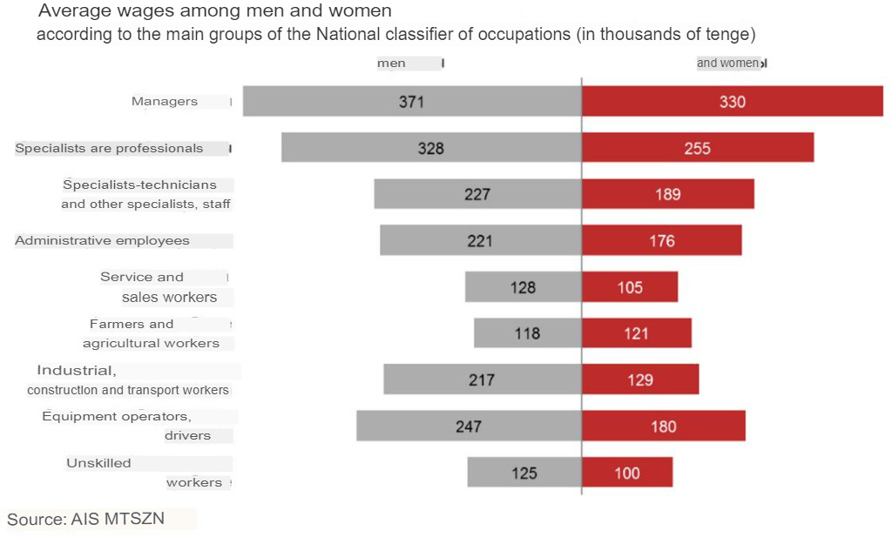
APPLYCABILITY IN KAZAKHSTAN/ CENTRAL ASIA
Same problems
Zero actions
The need for changes
2022 statistics

Slide 8
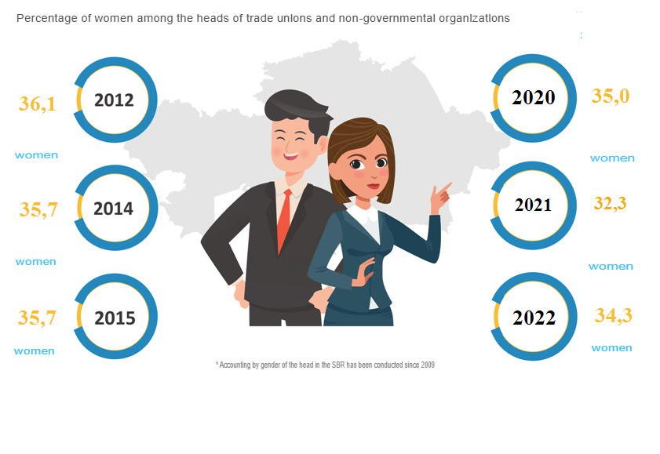

Slide 9
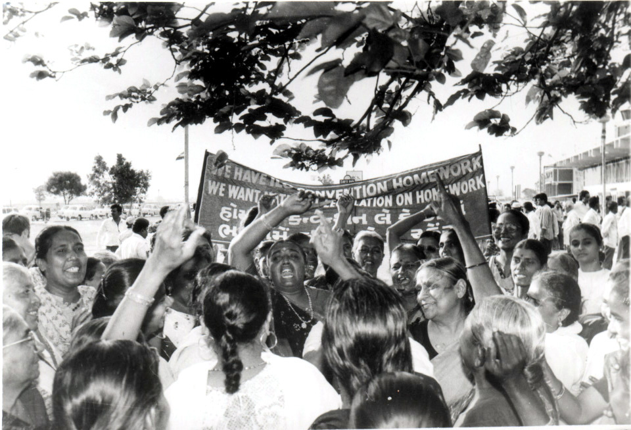

REFERENCES
SEWA's official website
"Learning from catalysts of rural transformation" Chapter 7. SEWA, India

Slide 10
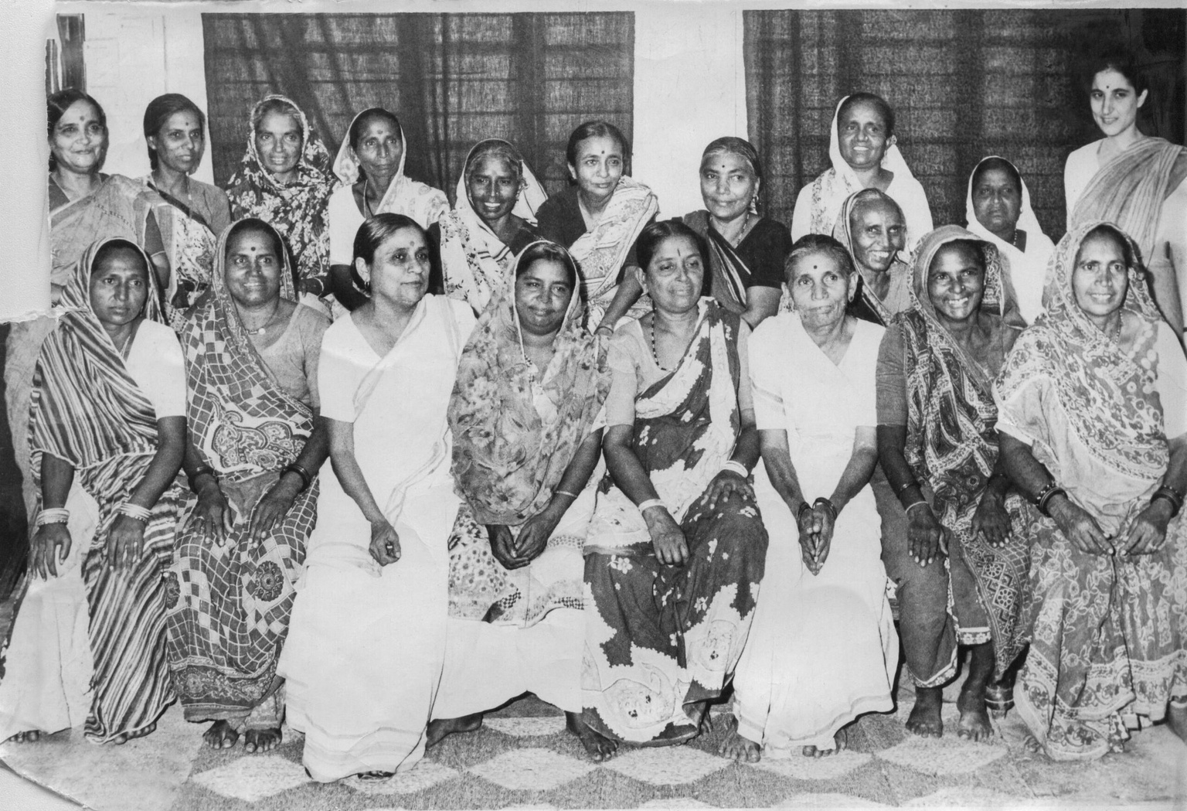
THANK YOU FOR ATTENTION!
MADE BY SYMBAT O., DIANA M., DANA D.

